Slide 1
Clustering New York City hospitals
Seo Young Choe
April 9, 2020

Slide 2
Introduction
Patients often needs to transfer to other hospitals
One of the risk factors of intra-hospital transfer is distance
Increasing distance between hospitals = Increasing risk of mortality
hospitals need to be aware of other nearby medical institutions, share capacity information and cooperate with each other

Slide 3
Data
Data acquisition
Foursquare.com
Data selection & cleaning
- New York City area: 32km radius of its center
- 50 medical centers: 2 excluded due to insufficient data

Slide 4
Method
Density-based Clustering (DBSCAN)
: clustering method that locates regions of high density that are separated from one another by regions of low density.
Distance: calculated by latitude and longitude
Clusters: 3 or more hospitals within 30km radius

Slide 5
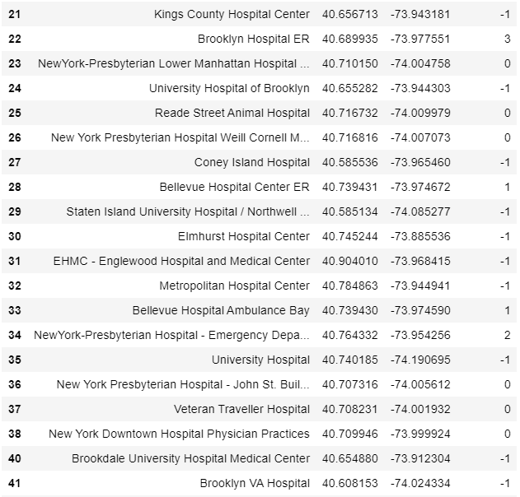
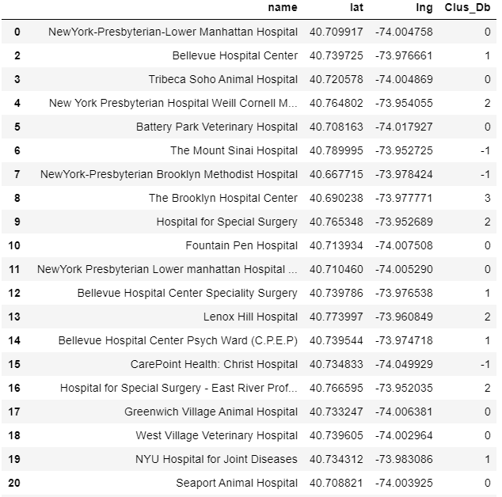
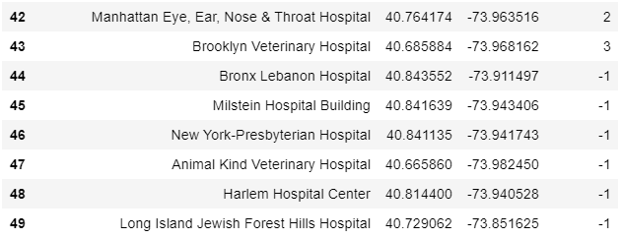
Results – Clusters

Slide 6
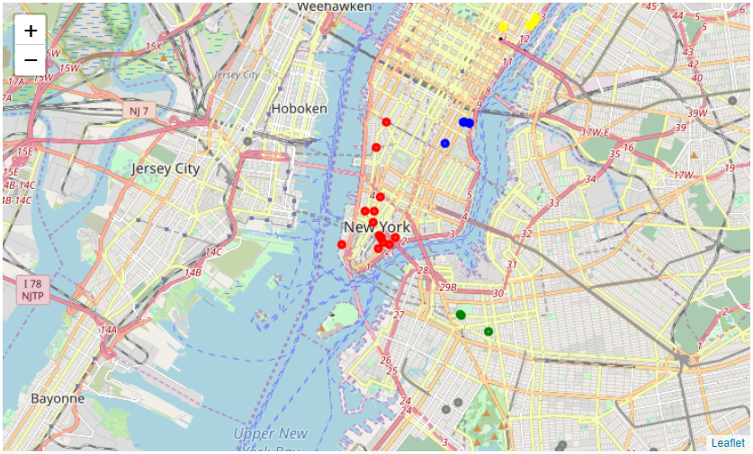
Results – Visualization
Red : Cluster 0
Blue : Cluster 1
Yellow : Cluster 2
Green : Cluster 3

Slide 7
Discussion & Conclusion
the results can be applied to other large cities with multiple hospitals.
poorly organized and hastily done patient transfer can significantly contribute to morbidity and mortality
It is important for hospitals to be aware of other nearby medical institutions, share capacity information and cooperate with each other in case of transfer

